Slide 1


Australia’s contribution to the C20C+ project: long AMIP runs with ACCESS1.3
Andrea Dittus, Andrew King and David Karoly
(with help from Christine Chung, Ruth Lorenz, Paola Petrelli, and Daithi Stone)

Slide 2
Australian contribution to C20C+
CLIVAR Climate of the 20th Century+ Project http://portal.nersc.gov/c20c/
Climate model simulations with specified observed SST, sea ice, greenhouse gases and aerosols
ACCESS1.3: UM atmosphere, CABLE land surface
10 long historical simulations (1959-2013).
10 long historicalNat simulations (1959-2013), with estimated human contribution to SST, ghg and aerosol increases removed
So far we have 8 completed historical simulations with testing of historicalNat set up.

Slide 3
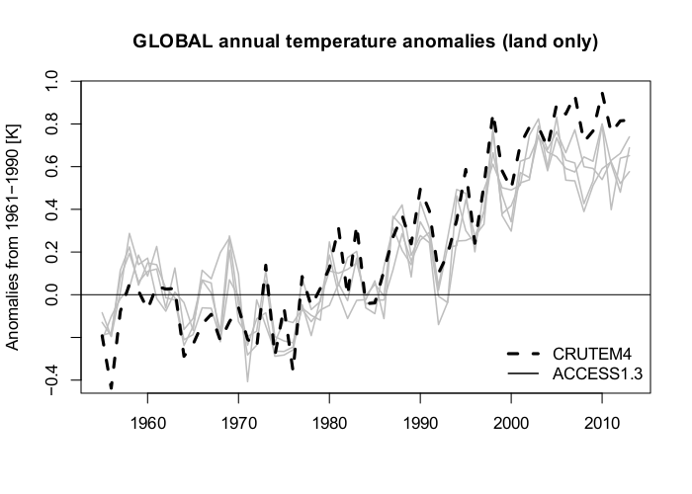
Evaluation of global metrics: surface temperature over land

Slide 4
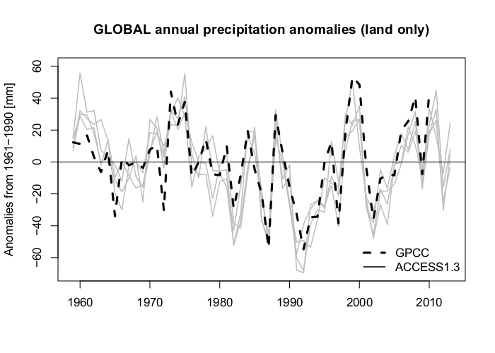
Evaluation of global metrics: rainfall over land

Slide 5
Next Steps
Priority 1: Complete long historical and historicalNat simulations
Priority 2: Use C20C+ simulations to evaluate ACCESS2 model
Priority 3: Use simulations to better understand response of global mean rainfall to global warming

